Slide 1
Low Beta Algorithm trading
Group: yu wang, Yan yu, Qiaodan Zuo

Slide 2
content
Beta-Neutral 101
Why Beta-Neutral
Algorithm Comparison
Detail Of Beta-Neutral Algorithm
Risk Measures of Beta-Neutral Algorithm
Conclusion

Slide 3
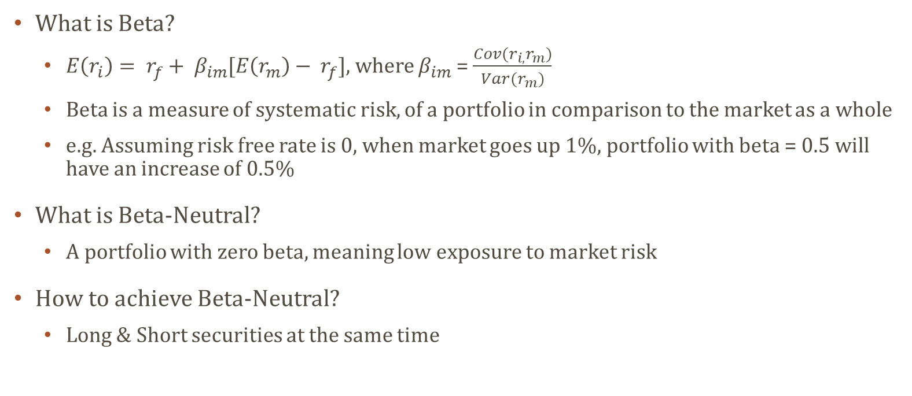
Beta neutral 101
What is Beta?
$E\left(r_{i}\right)= r_{f}+ β_{im}[E\left(r_{m}\right)− r_{f}]$, where $β_{im}$ = $\frac{Cov(r_{i,}r_{m})}{Var(r_{m})}$
Beta is a measure of systematic risk, of a portfolio in comparison to the market as a whole
e.g. Assuming risk free rate is 0, when market goes up 1%, portfolio with beta = 0.5 will have an increase of 0.5%
What is Beta-Neutral?
A portfolio with zero beta, meaning low exposure to market risk
How to achieve Beta-Neutral?
Long & Short securities at the same time

Slide 4
Why beta-neutral
Why is Beta-Neutral Strategy useful?
A major way to avoid market risk
Stable performance even during crashes, avoid survivorship bias
Lower systematic risk with well diversified portfolio
Who would like Beta-Neutral Strategy?
Universities
Pension Funds
Family Offices
Hospitals
Sovereign Wealth Funds
etc.

Slide 5
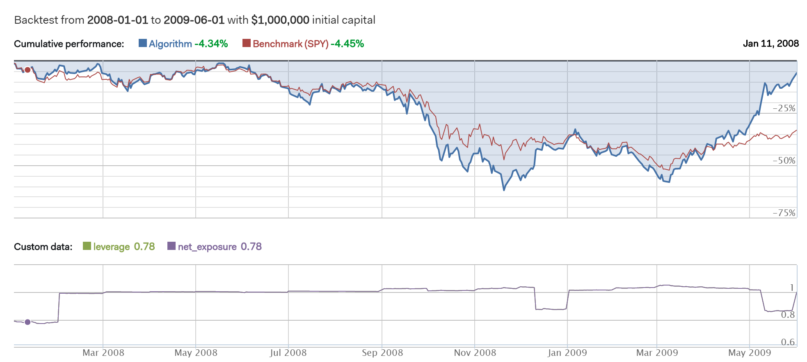
Non Beta-Neutral (long only)

Slide 6
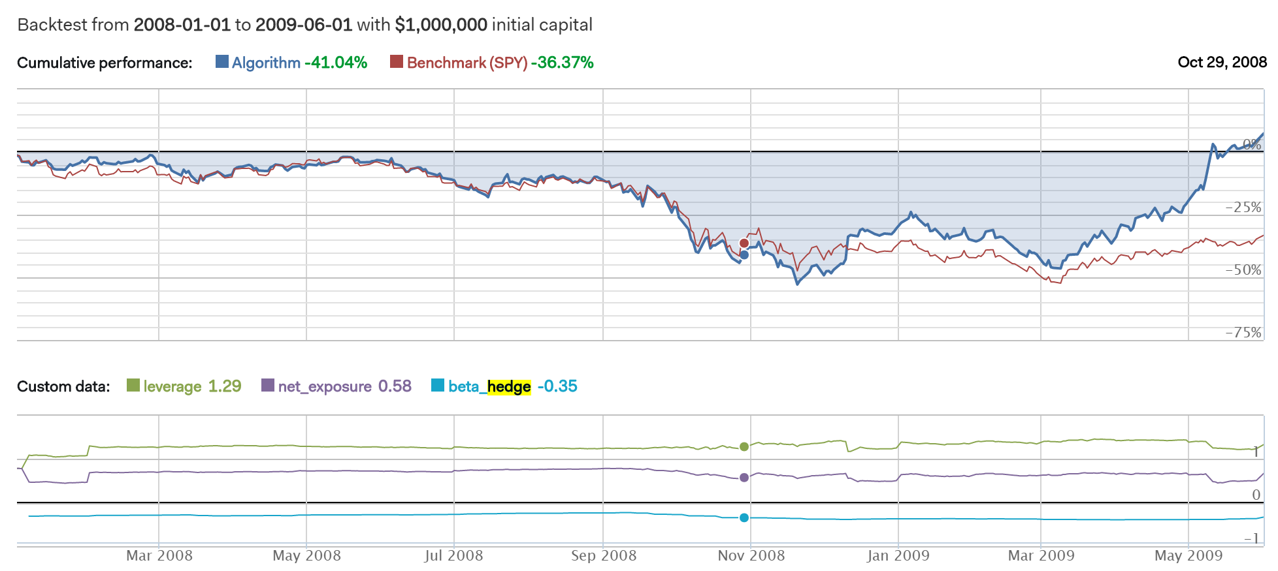
Non Beta-Neutral (Beta-hedge)

Slide 7
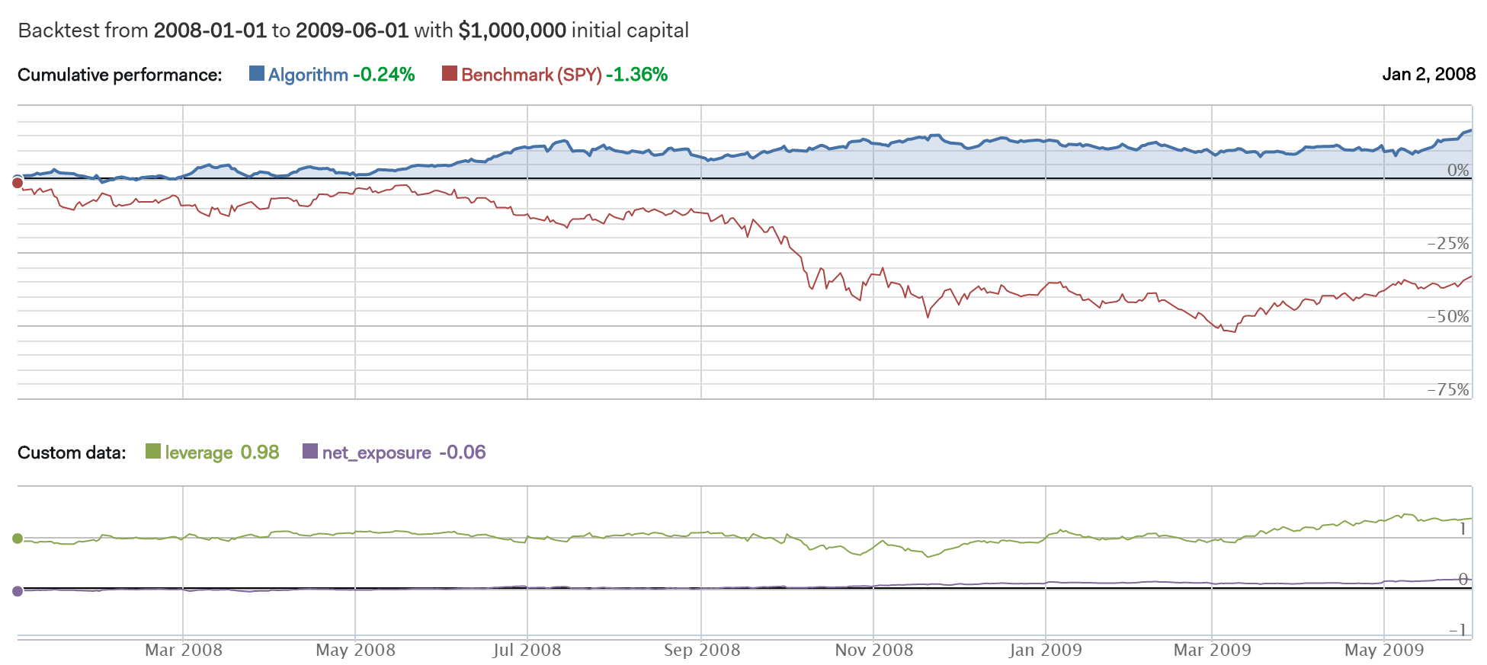
Beta-Neutral

Slide 8
Risk measure comparison

Slide 9
Detail of Beta-neutral Algorithm
Quantopian
Leading back testing platform using Python 2.x
Momentum
Bull stocks or bear stocks usually have momentum due to the late react of investors
Buy winners and sell losers
Pair Trading
Long & short pairs of security
Theoretically profitable in all market situation, leads to market neutral
Assumptions
Transactions fee: $0.0075/Share, $1/Order
Benchmark: SPDR S&P 500 ETF Trust (SPY)
Slippage: 0.025 volume limit, 0.1 price impact
Notes:
VolumeShareSlippage(volume_limit=0.025, price_impact=0.1)
You can take up to 2.5% of a minute's trade volume
For the 10-share order, the price impact is .1 * (10/1000) * (10/1000), or .001%.
The slippage is calculated by multiplying the price impact constant by the square of the ratio of the order to the total volume.

Slide 10
Risk Measures of Beta-neutral algorithm
Beta
Exposure to market risk
Alpha
Performance compares to benchmark (SPY)
Sharpe Ratio
The average return earned in excess of the risk-free rate per unit of volatility (>1 is good)
Volatility
The stableness of portfolio
Max Drawdown
Maximum percentage loss during one year period

Slide 11
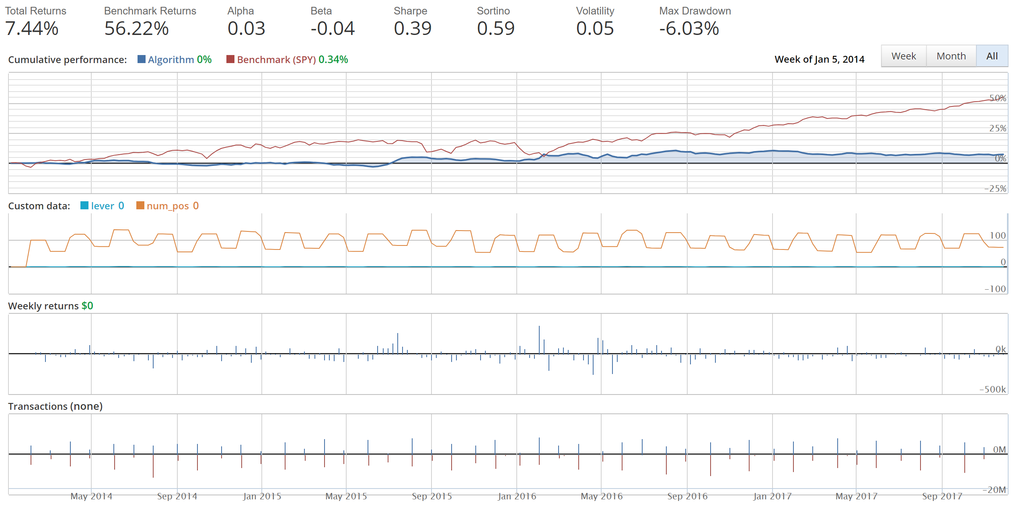
Recent 3 years

Slide 12
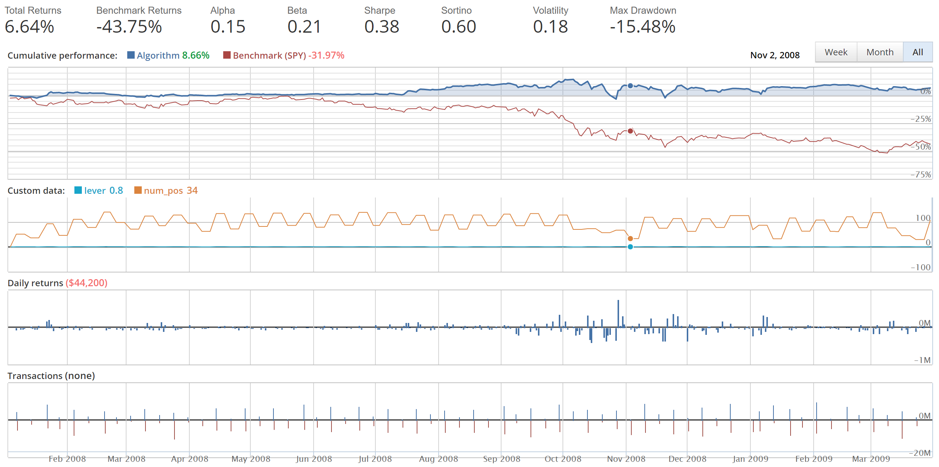
2008 Financial crisis

Slide 13
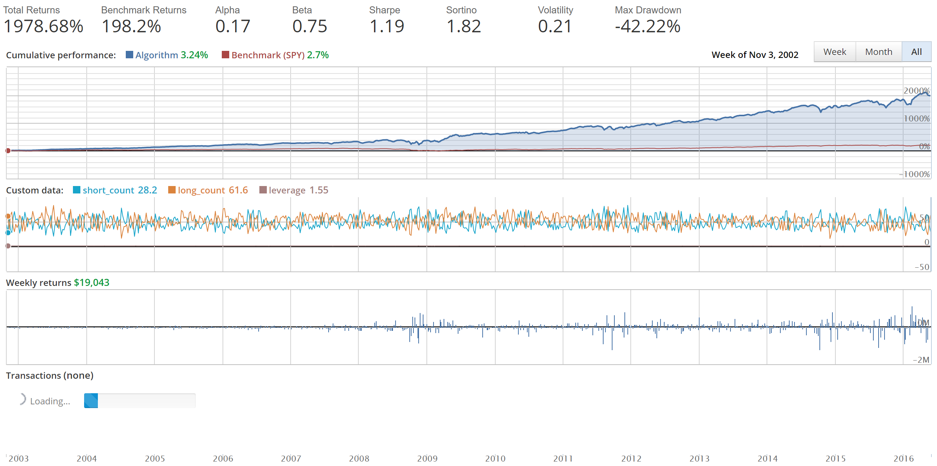
Who cares beta!

Slide 14
Conclusion

Slide 15
references
Backtesting Bias and How we avoid it, https://keepingstock.net/backtesting-bias-and-how-we-avoid-it-fe598930cb1
9 Mistakes Quants Make that Cause Backtests to Lie, https://blog.quantopian.com/9-mistakes-quants-make-that-cause-backtests-to-lie-by-tucker-balch-ph-d/
Quantopian Allocation, https://www.quantopian.com/allocation
The Art Of Not Following the Market, https://www.quantopian.com/posts/quantopian-lecture-series-the-art-of-not-following-the-market
Investopedia, https://www.investopedia.com/
Lecture Notes

Slide 16
Questions

Slide 17
Thank you

